Slide 1

INTRO TO AI
Sentiment Analysis Workshop

Slide 2
LET’S TALK AI
-

Slide 3

What is AI?
Building smart programs capable of performing tasks that typically require human intelligence.

Slide 4
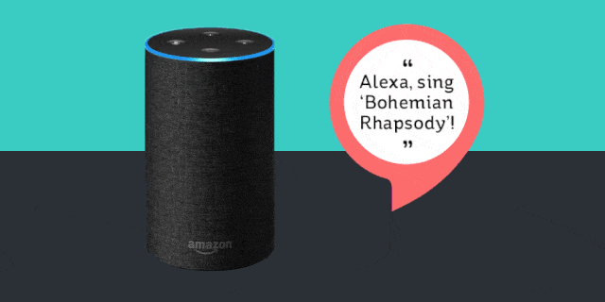
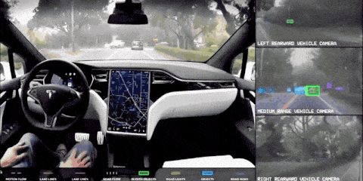

NOW, REALLY

Slide 5
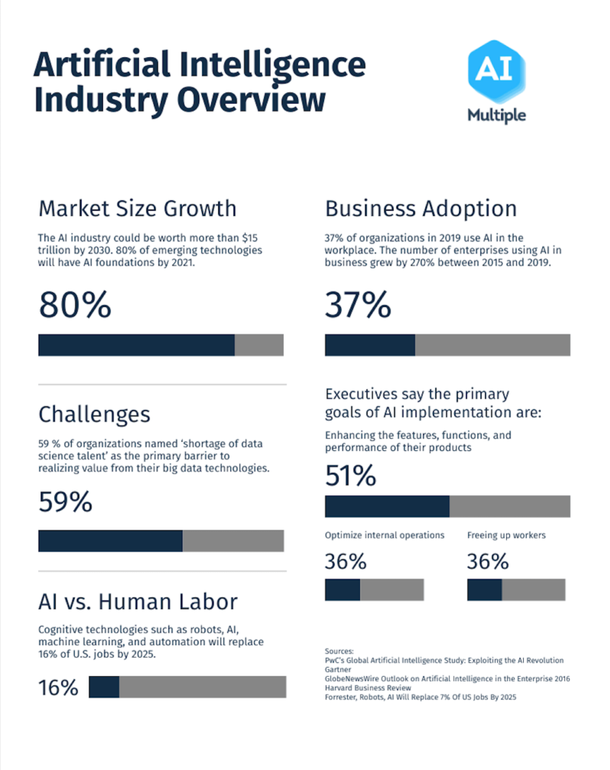

TRUTH IS…
AI is still a baby. It’s difficult to predict what it would look like in 20-30 years.
But today, it’s taking over the world rapidly!

Slide 6
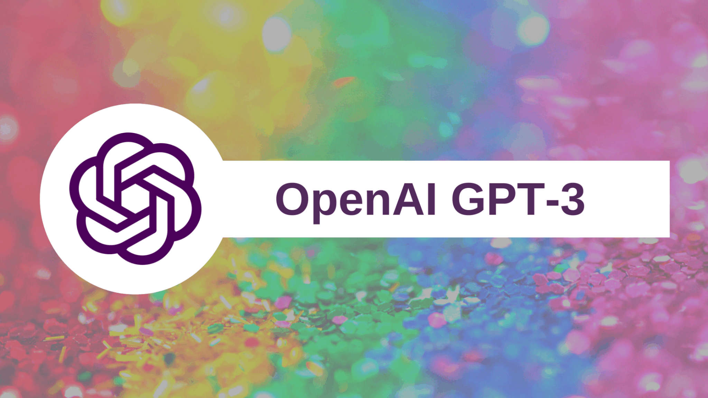

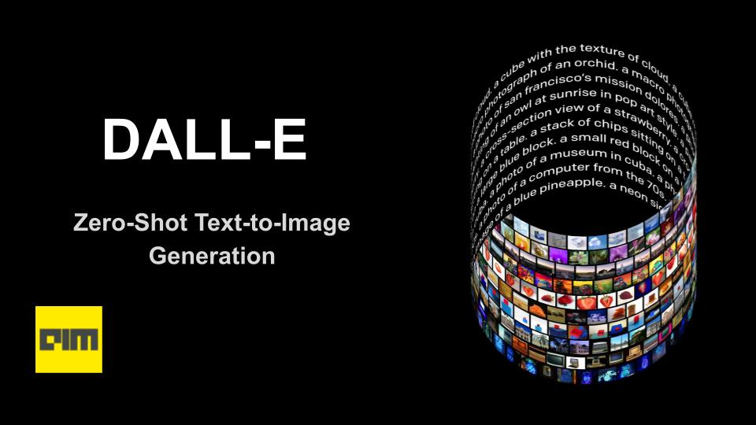

STATE-OF-THE-ART AI
YOU CAN USE!!!

Slide 7
02
Sentiment Analysis Workshop

Slide 8
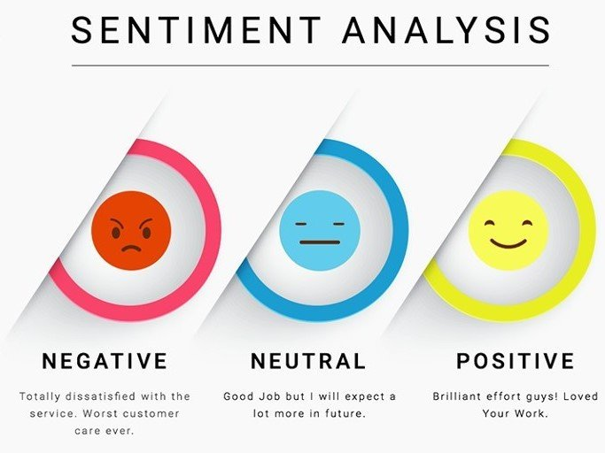
What is Sentiment Analysis?
The process of using Natural Language Processing(NLP) to determine if the polarity of the given text is positive, negative or neutral.
‘You guys did a great job!’ - Positive
‘I was not pleased with the service’ - Negative
‘I had to wait 2 hours for service. Loved every minute of it!’ - Negative
This task can get difficult, especially when sarcasm is involved.

Slide 9
Practical Uses
Analyzing customer feedback(reviews, surveys, social media interactions, ect.)
Determine what customers really like/hate
Sort large datasets
Better understand feedback

Slide 10
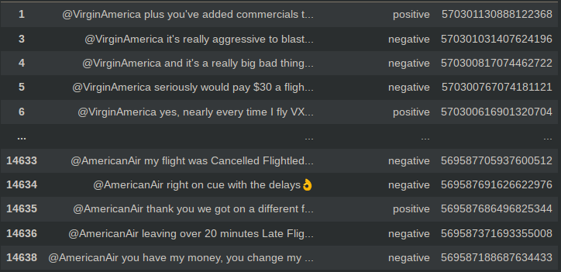
Training Data
We will be working with Tweets to airlines and use sentiment analysis to determine the sentiment of a given phrase.
Each Tweet has a value determining if the phrase is positive or negative. We will use this value for training.

Slide 11
Basic Workflow
Tweet data is downloaded
Data is filtered to exclude neutral statements
Words are tokenized(Converted into numbers)
Model is designed
Model is trained(This will take some time)
Model is tested with our own data
Each of these steps will be covered in the workshop

Slide 12
Model Overview
Words
Embedding →
Word meanings
Long Short-Term Memory →
Summary data
Dense →
Sentiment

Slide 13
Teamwork
It is highly recommended that you work in pairs!
This will make the workshop easier
It will also help with grasping the topics covered
Teamwork is optional, but highly recommended!

